Slide 1
MARKETING ANALYSIS
CodeX Energy Drink
CREATED BY:
Hafiza Muqaddas Hafeez

Slide 2
About CodeX
German company operating in Food & Beverage Industry.
Recently launched their energy drink product in 10 cities of India.
CodeX is at 5th position in terms of market capitalization.
Objective
The company wishes to increase brand awareness, market share and product development.
They conducted a survey in those 10 cities and received responses from 10k respondents.

Slide 3
1. Introduction
The objective of this report is to present a comprehensive analysis of the energy drink market based on survey data collected from respondents. The analysis aims to uncover key insights into consumer preferences, demographics, brand perception, and purchase behavior, with the goal of informing marketing strategies and product development initiatives in the food and beverage industry.

Slide 4
Dataset Description
The dataset used for analysis consists of three main sheets:
dim_respondents: This sheet contains information about survey respondents, including unique identifiers (Respondent_ID), respondent names (Name), categorized age groups (Age_Group), genders, city IDs (City_ID), and tier classifications (Tier).
dim_cities: Provides details about cities, including unique city identifiers (City_ID), city names, and tier classifications.
fact_survey_responses: Contains responses to various survey questions related to energy drink consumption, brand perception, marketing channels, packaging preferences, and more.

Slide 5
Data Preprocessing
Prior to analysis, the dataset underwent several preprocessing steps to clean and organize the data:
Merged the dim_respondents and dim_cities sheets with the fact_survey_responses sheet using VLOOKUP functions to create a unified dataset with comprehensive respondent information.
Standardized responses in the "Heard_before" and "Tried_before" columns to ensure consistency and accuracy.
Entries where respondents indicated they had not tried the product but provided a response in the "Taste_experience" column were converted to 0 to maintain uniformity and facilitate accurate analysis.
Created an "Age_Category" column using the IF formula to categorize respondents into age groups (Youth, Middle Age, Senior) based on their age.

Slide 6
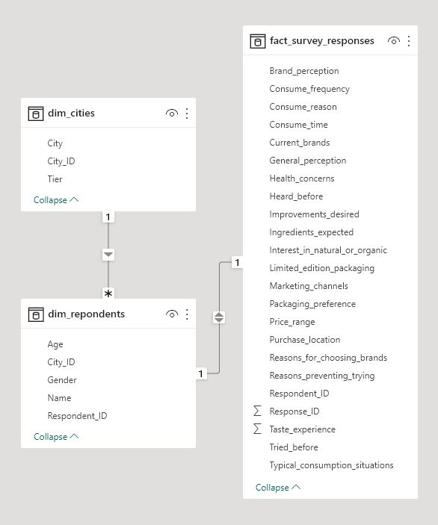
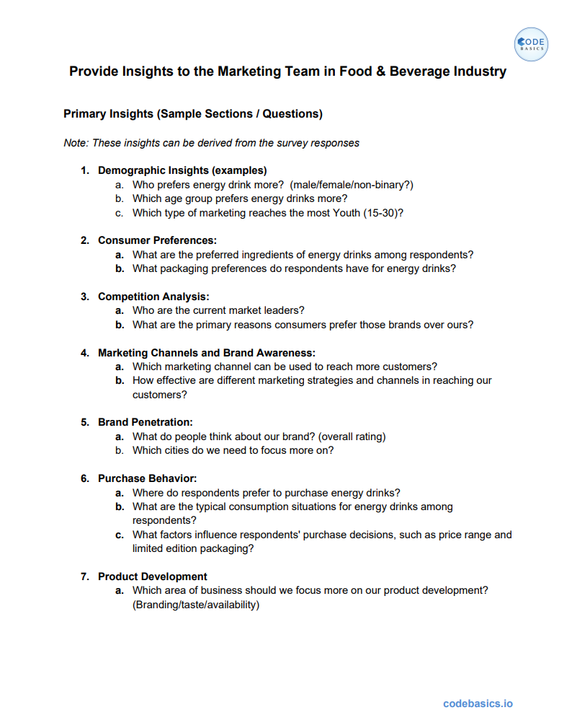
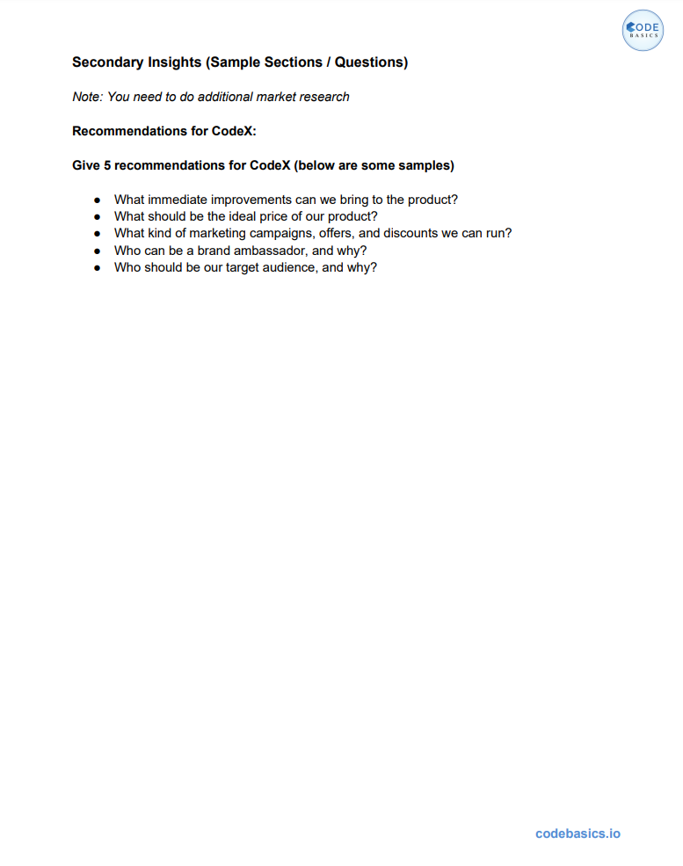
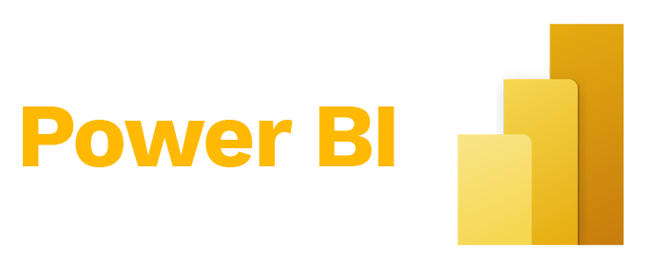
HOW?
Data, Requests and tools
Tools for Analysis and Visualization

Slide 7
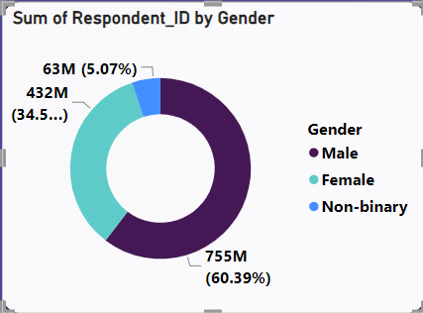
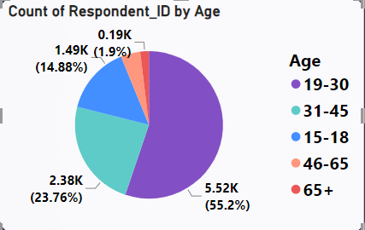
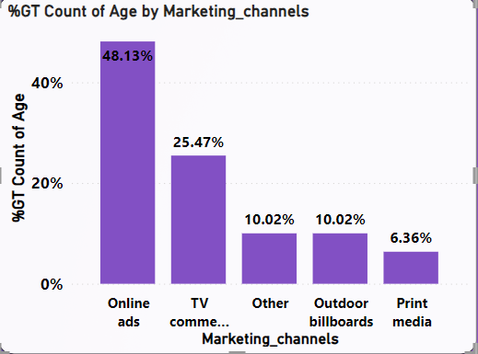
Q1.a Who prefers energy drink more?
DEMOGRAPHIC INSIGHTS
Q1.b Which age group prefers energy drinks more?
Q1.c Which type of marketing reaches the most Youth (15-30)?
FINDINGS?
60% Male consumers prefer energy drink as compared to other respondents.
55% Youth of age group 19-30 years accounted for energy drink consumption.
48% of youths are coming from Online Ads.

Slide 8
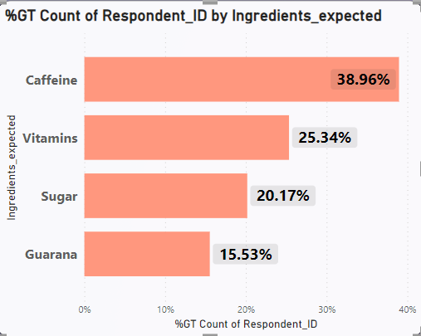
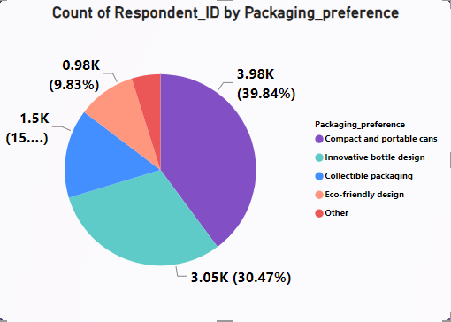
Q2.a What are the preferred ingredients of energy drinks among respondents?
CONSUMER PREFERENCES
Q2.b What packaging preferences do respondents have for energy drinks?
FINDINGS?
Caffeine and Vitamins are most preferred ingredients of energy drink among respondents.
Compact and portable cans are preferred by 40% of respondents.
However, 30% of respondents chosen Innovative bottle design as their preference.

Slide 9
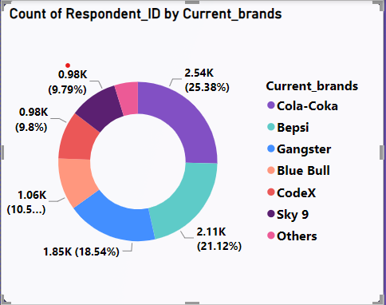
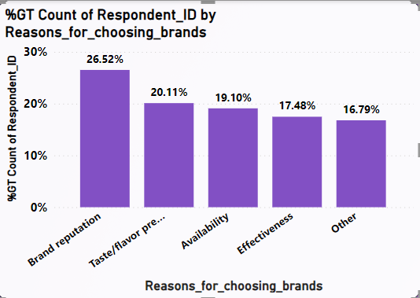
Q3.a Who are the current market leaders?
COMPETITION ANALYSIS
Q3.b What are the primary reasons consumers prefer those brands over ours?
FINDINGS?
With 25.38% of market share Cola-Coka is current market leader.
CodeX holds 10% of market share.
For 26.52% of respondents, Brand Reputation is primary reason for choosing other brands over ours.
Taste/flavour preference and Availability are two another major factors.

Slide 10
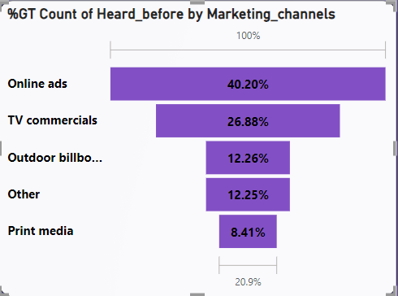
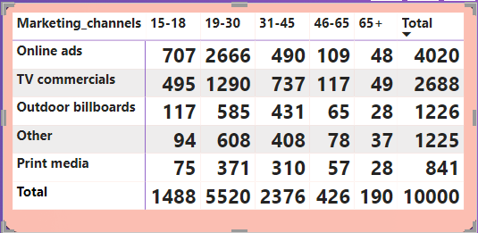
Q4.a Which marketing channel can be used to reach more customers?
MARKETING CHANNELS AND BRAND AWARENESS
Q4.b How effective are different marketing strategies and channels in reaching our customers?
Marketing Channels vs Age
FINDINGS?
Online Ads are most effective way of reaching more customers.
Digital Age is mostly using online services.
Online ads are mostly reaching youth of age 19-30.

Slide 11
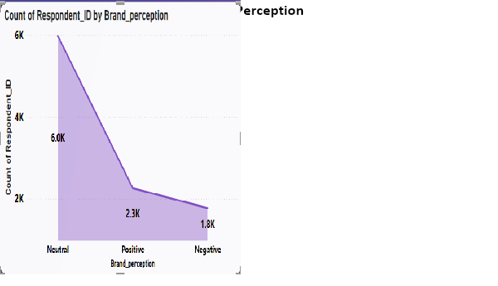
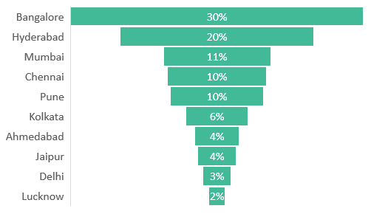
Q5.a What do people think about our brand? (overall rating)
BRAND PENETRATION
Q5.b Which cities do we need to focus more on?
FINDINGS?
6.0k of respondents are neutral about brand. 2.3k are positive about brand.1.8k are negative about brand.
Average Rating of 3.28 is given by respondents who have tried and heard about our brand before.
2026 respondents tried and heard about CodeX before.
Out of 2828 respondents from Bangalore, 1670 has not heard about our brand before, which accounts to 30%

Slide 12
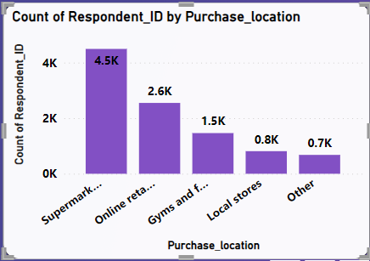
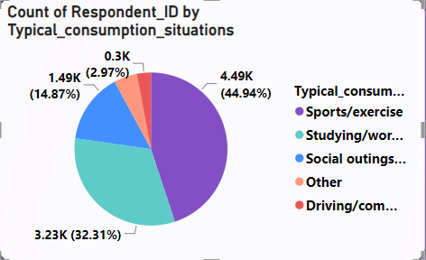
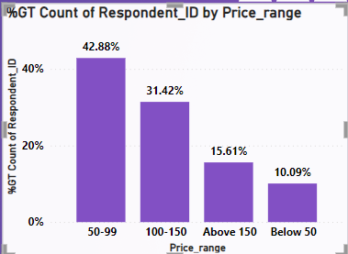
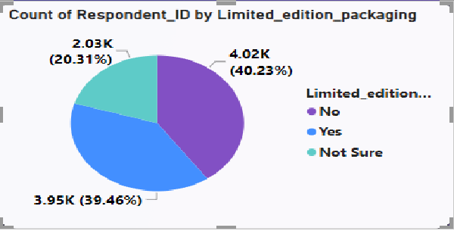
Q6.a Where do respondents prefer to purchase energy drinks?
PURCHASE BEHAVIOR
Q6.b What are the typical consumption situations for energy drinks among respondents?
Q6.c What factors influence respondents' purchase decisions, such as price range and limited edition packaging?
Price Range
FINDINGS?
4.5k of respondents prefers purchasing drink from Supermarkets & 26% from Online Retailers.
77% of Respondents typically consume energy drinks during Sports/exercise and Studying/working late.
74% of respondents want price range to be 50-150.
Limited edition packaging is not a influencing factor

Slide 13
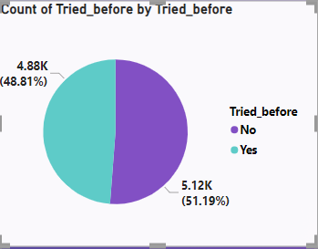
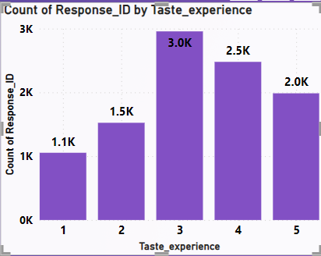
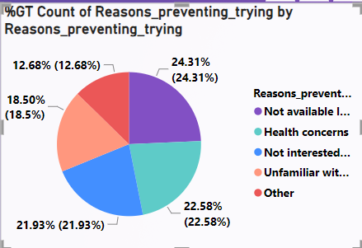
Q7.a Which area of business should we focus more on our product development? (Branding/taste/availability)
PRODUCT DEVELOPMENT
FINDINGS?
51% of respondents have not tried our product before.
Availability and Health concerns are two major factors preventing users from trying.
3.0k of respondents who have tried out product rated taste experience 3.
We should focus on increasing brand presence and availability of our products.

Slide 14
RECOMMENDATIONS
What immediate improvements can we bring to the product?
We should reduce sugar content.
Add more natural and organic ingredients.
Launch different flavors.
Add Caffeine and Vitamins.
What should be the ideal price of our product?
Ideal price range will be between 51-150.
What kind of marketing campaigns, offers, and discounts we can run?
We can run Online Ads promoting as healthy energy drink having less sugar, and natural, organic ingredients.
Collaborate with Influencers and ask them to promote our product.
We should run a campaign of giving trial packs to consumers and ask them to try and review.
Who can be a brand ambassador, and why?
Virat Kohli should be our brand ambassador, because he is a famous sports person, having wider presence in social media with 255M followers on Instagram.
Who should be our target audience, and why?
Our target audience should be youth of age group 19-30, because they consume mostly during Sports/Exercise and Studying/working late.

Slide 15


